Slide 1

Latvia University of Life Sciences and Technologies
Faculty of Engineering and Information Technologies
Information Technologies in Geoinformatics( INFT5056)
Kamaleshwaran Asokan
(IT25005)

Slide 2
Introduction
Analyze Temperature and Rainfall data in India
Purpose to Analyze Temperature and Rainfall data in India using PostgreSQL, PostGIS, and QGIS.
The goal is to identify patterns and regions most affected by climate extremes.

Slide 3
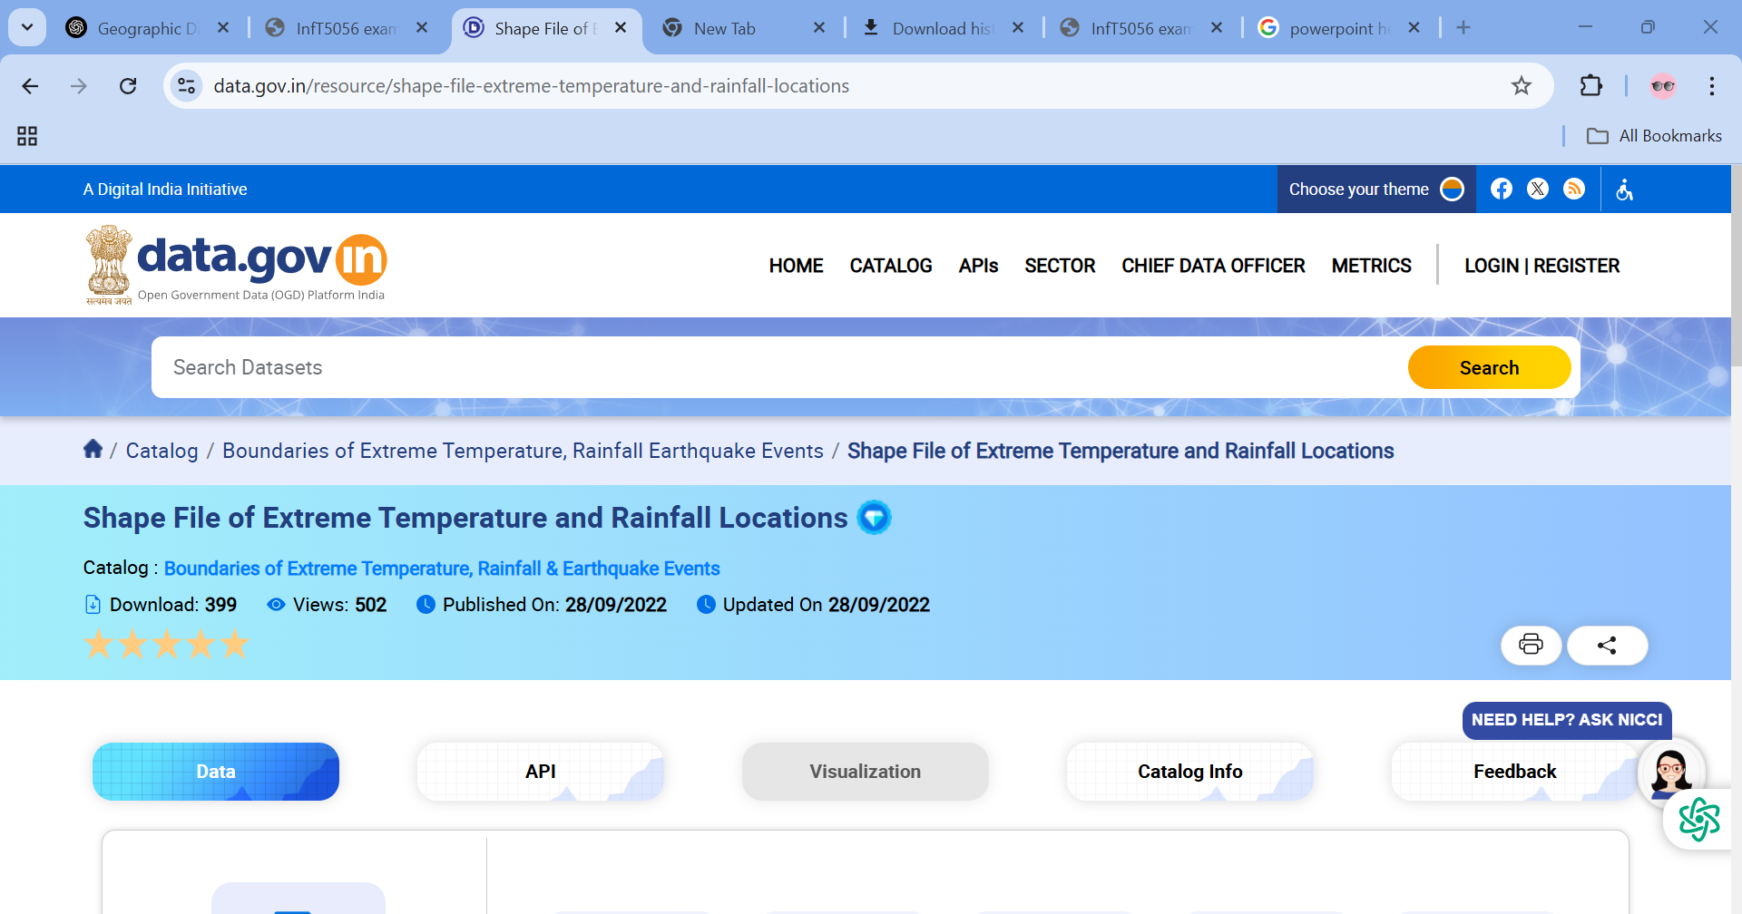
DATA SET
The dataset is named Extreme temperature and Rainfall locations data in India, is a dataset of the India country.
Format : ShapeFile
The data with attributes like state, basin, and coordinates.
Data was downloaded from https://www.data.gov.in/resource/shape-file-extreme-temperature-and-rainfall-locations

Slide 4
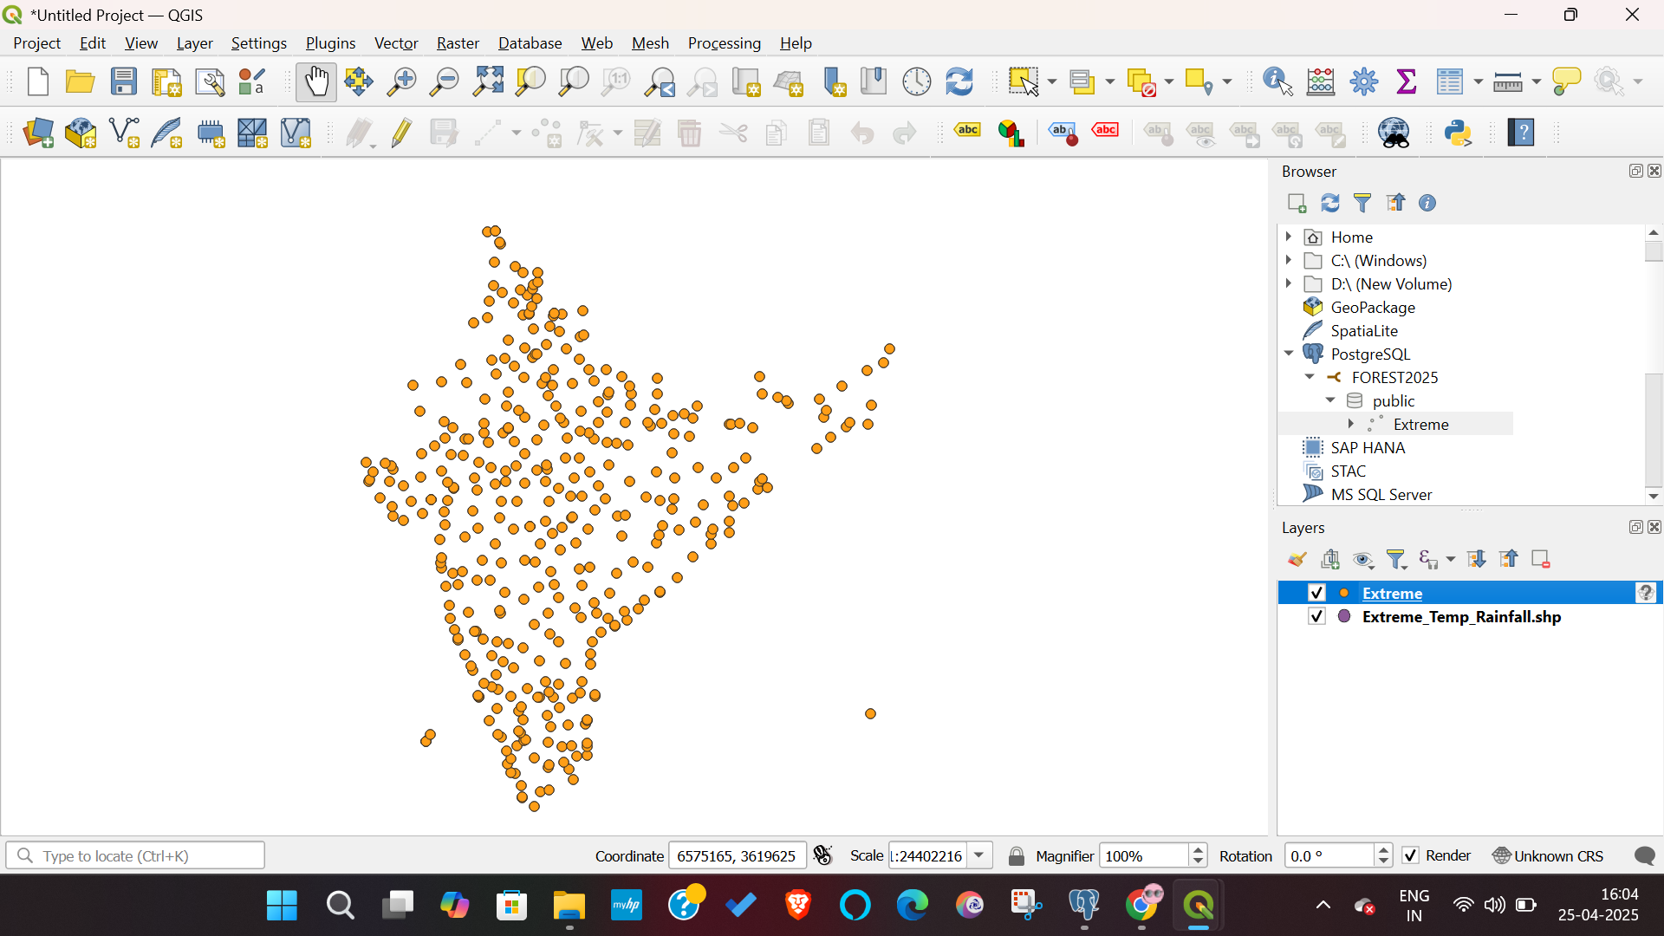
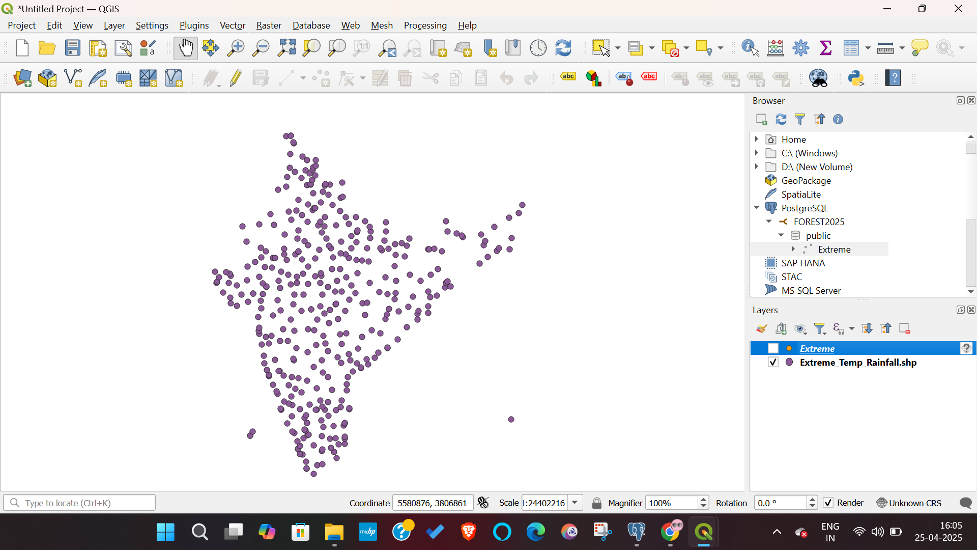
Loading the Shapefile into QGIS

Slide 5
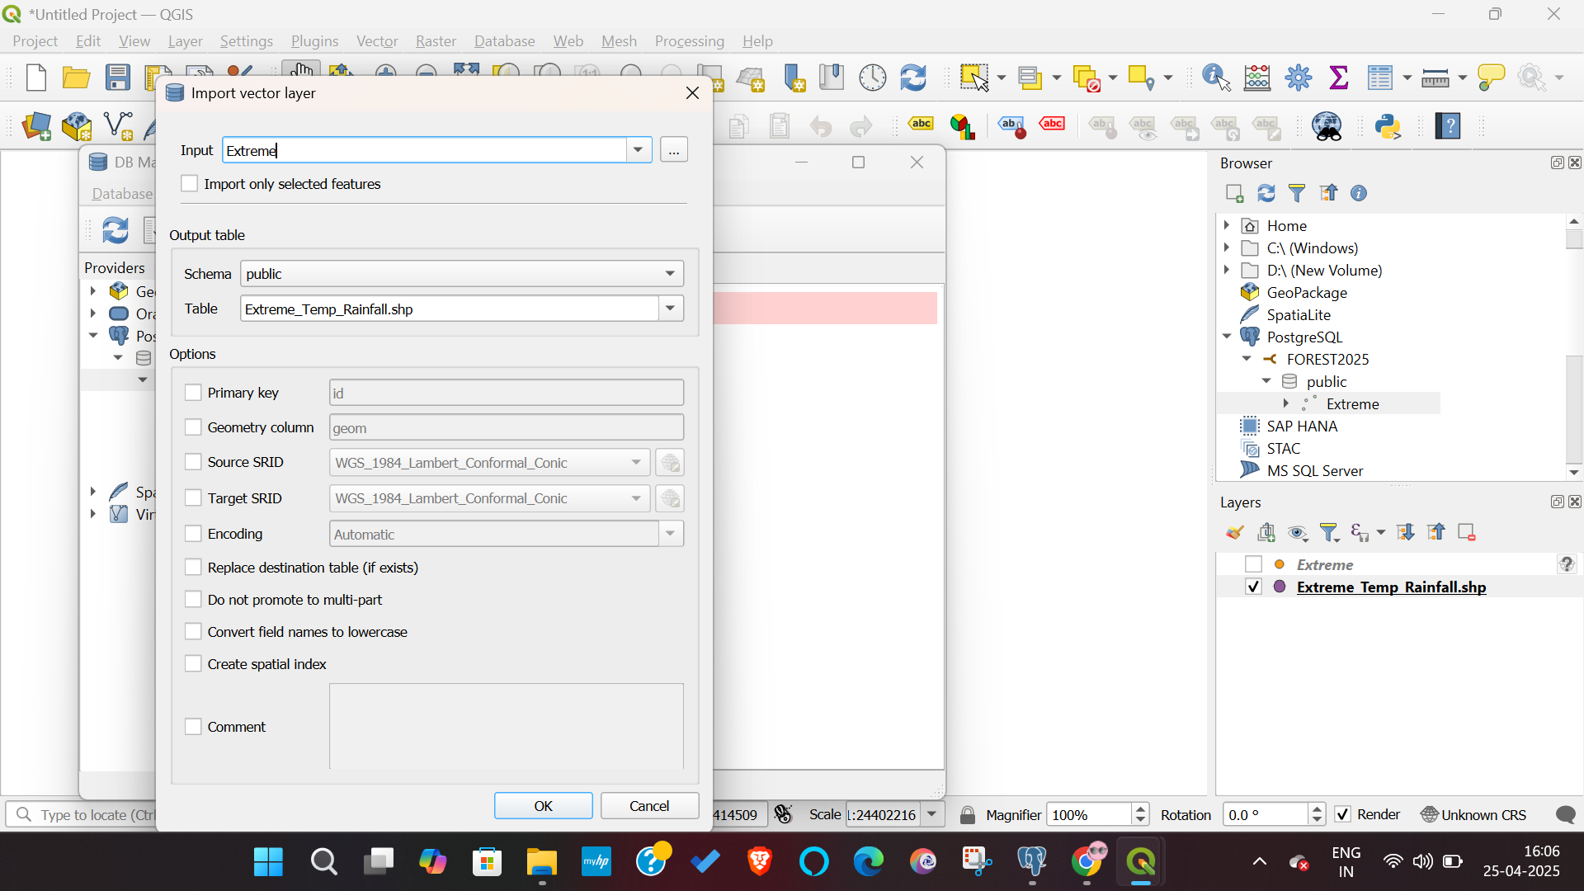
Importing the Data

Slide 6
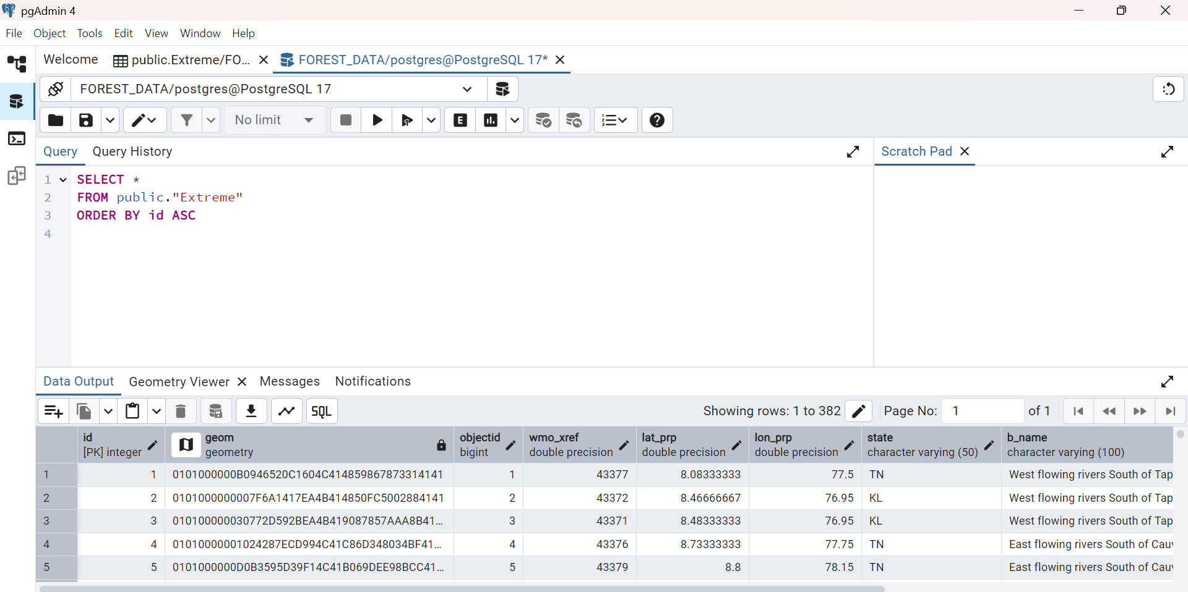
Overview Data:
The dataset contains 500 + station monitoring across 28 states in India .
It includes like station ID , basin . Frequency etc

Slide 7
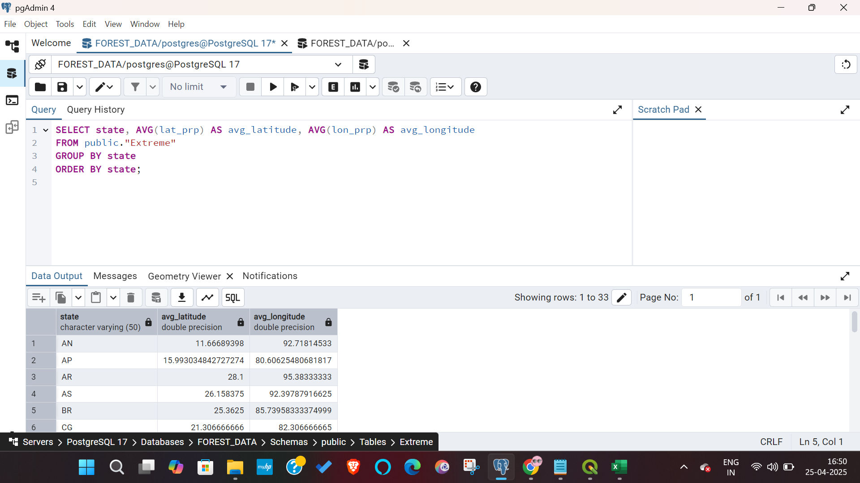
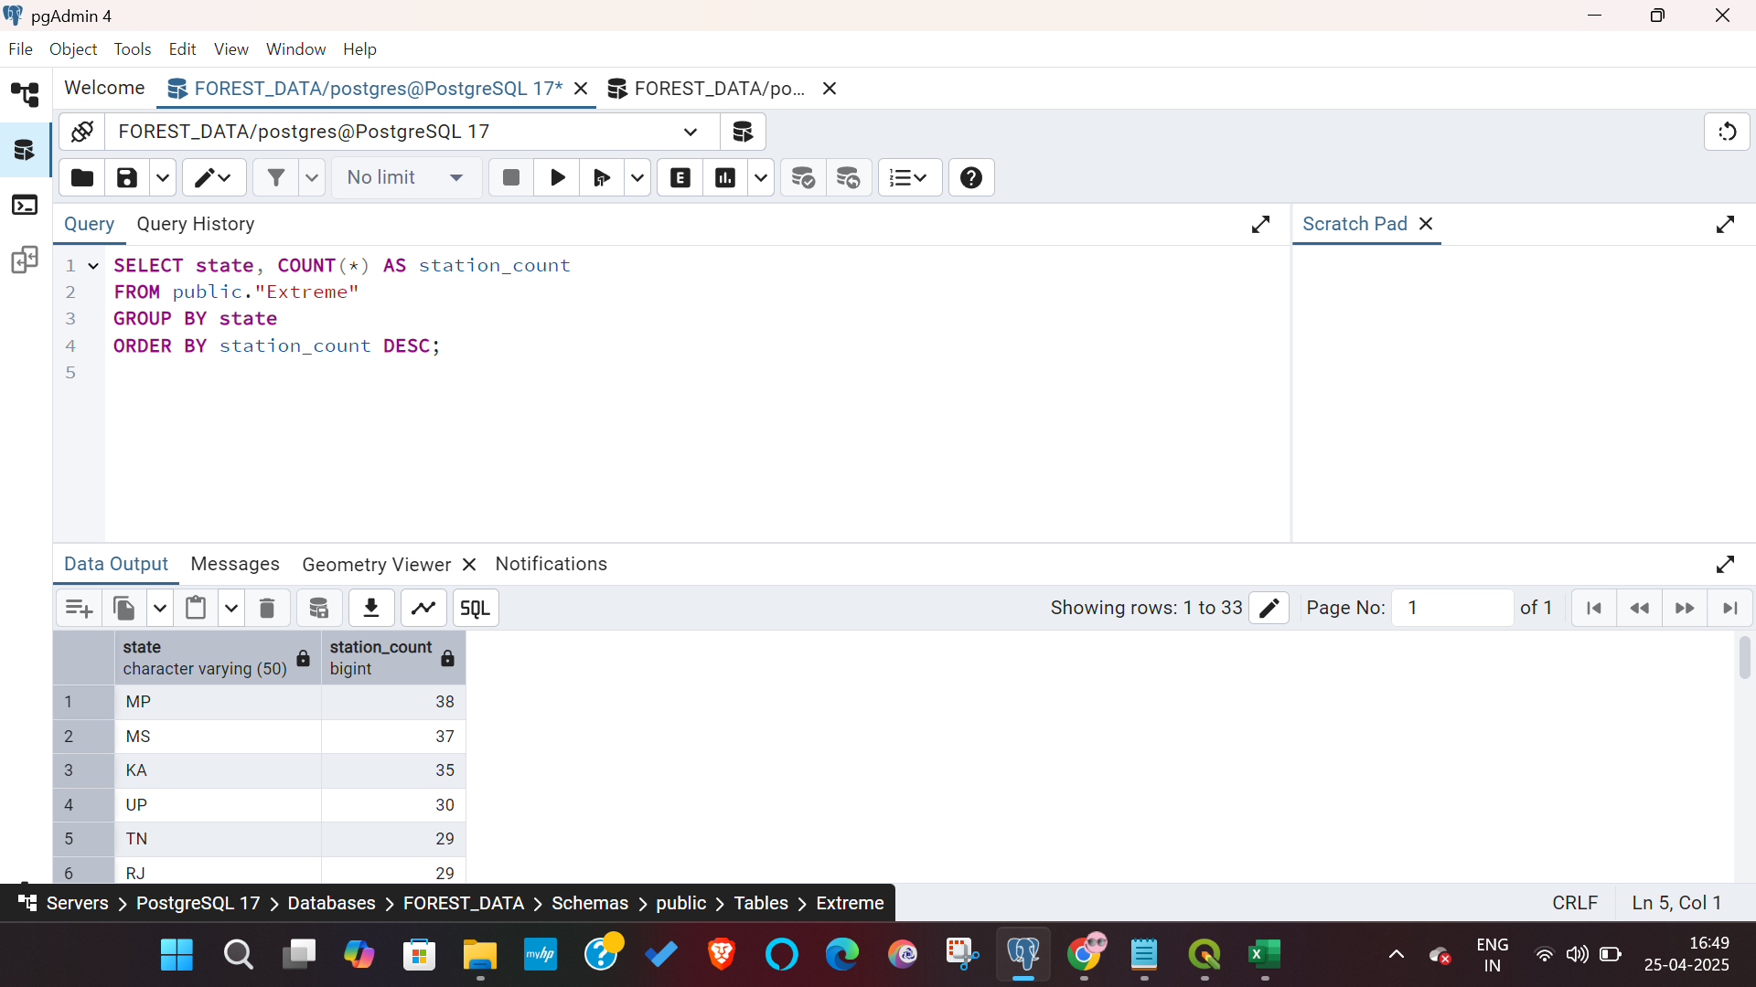
SQL Queries:
To get the average latitude and longitude for each state:
To count the number of stations per state:

Slide 8
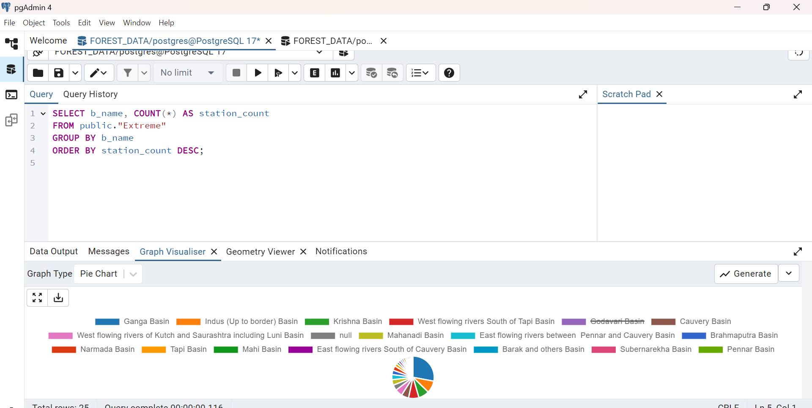
To count the number of stations in each basin:

Slide 9
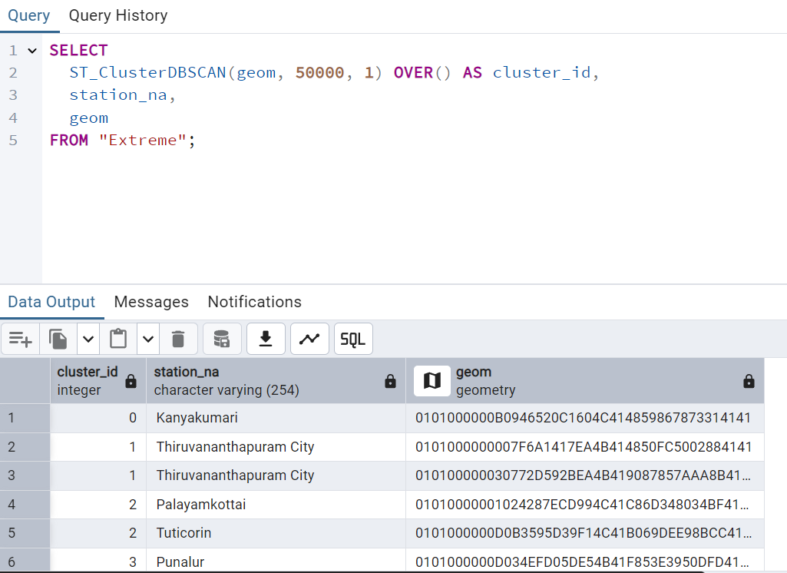
Spatial Clustering Cluster Stations into Groups (50km Radius)

Slide 10
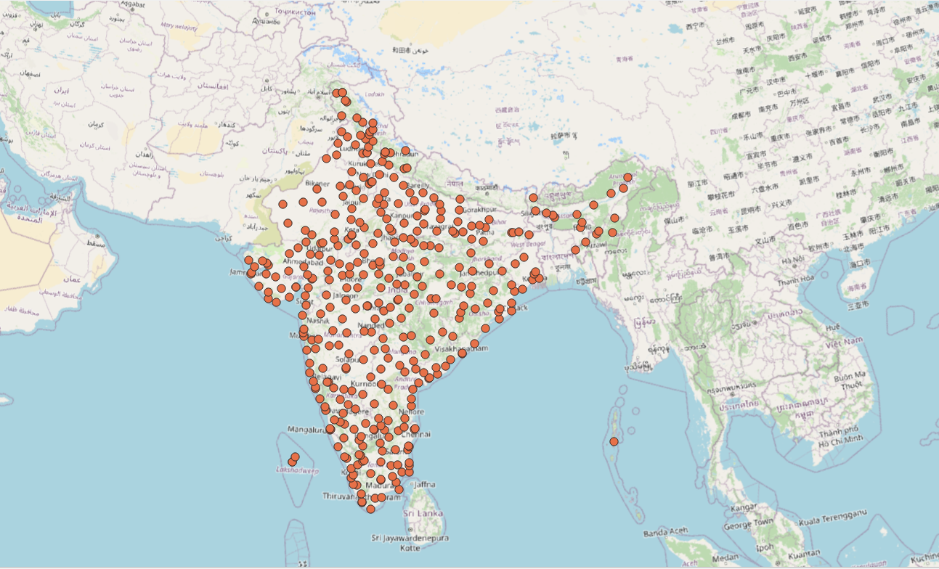
Map view

Slide 11
Conclusion:
In conclusion, establishment of a database based on Extreme temperature and Rainfall locations in India using PostGIS and QGIS has achieved its significant results and outcomes

Slide 12

Thank You

